Slide 1
Implementing a Collaborative Filtering Recommendation System Using Google Dataproc, Apache Spark, and Machine Learning
Arsiema Yohannes

Slide 2
Table of Contents
Introduction
Design
Why Did We Choose This Approach?
Implementation
How Was It Done?
Testing
Enhancement Ideas
Conclusion

Slide 3
Introduction
Objective: Create a recommendation system to provide personalized suggestions.
Context: Leveraged cloud computing and machine learning to efficiently handle large datasets.
Scope: Utilized Google Dataproc for cluster management, Apache Spark for data processing, and collaborative filtering for recommendation generation.

Slide 4
Design
Google Dataproc:
Purpose: Managed Spark and Hadoop clusters on Google Cloud Platform.
Benefits: Simplified cluster setup and management, scalability, cost efficiency.
Apache Spark:
Purpose: Distributed data processing engine for handling large-scale data.
Benefits: Fast in-memory processing, supports complex analytics and machine learning tasks.
Machine Learning (Collaborative Filtering):
Purpose: Algorithm used to provide personalized recommendations based on user preferences and behaviors.
Benefits: Improved accuracy in predicting user interests and enhancing user experience.

Slide 5
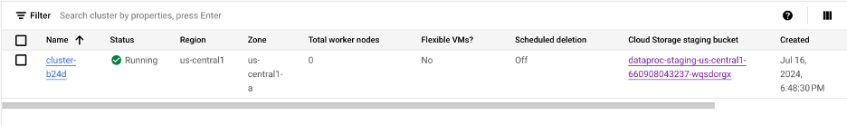
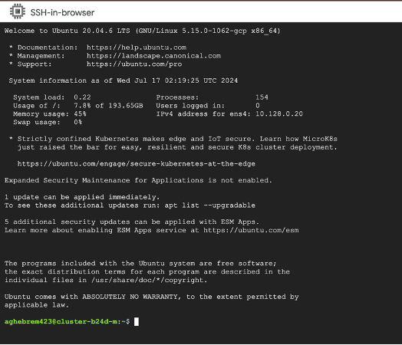
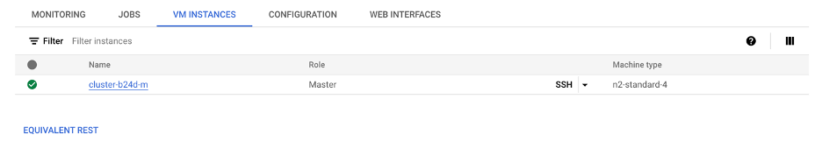
Implementation
Set Up a Dataproc Cluster:
Created and configured a Dataproc cluster to handle Spark jobs.
SSH into the Dataproc Cluster:
Accessed the cluster for configuration and execution of scripts.

Slide 6
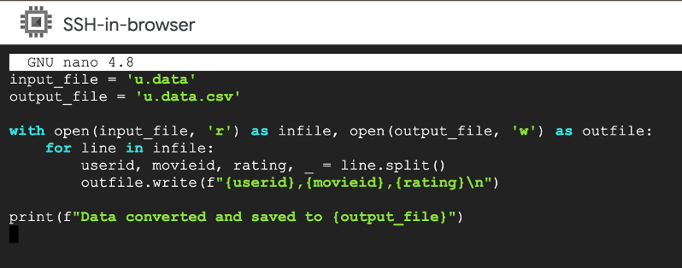
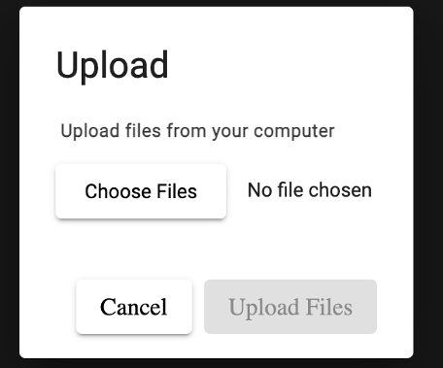
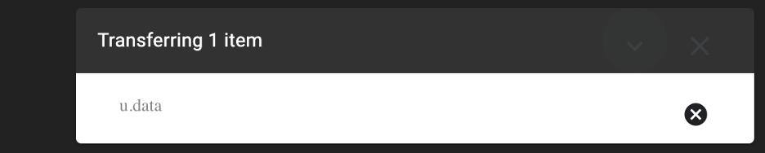
Cont.
Data Conversion Script:
Created convert_data.py to preprocess data.
Upload Data File:
Uploaded u.data to the cluster for processing.

Slide 7
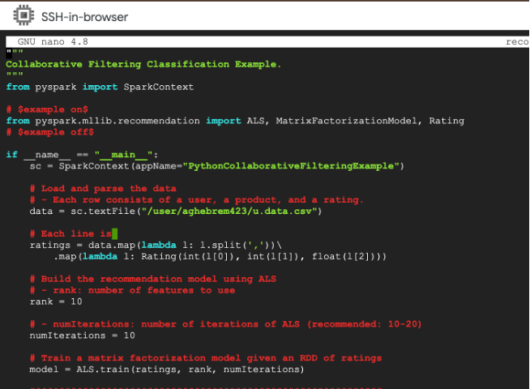
Cont.
sudo apt-get update
sudo apt-get install default-jdk scala git -y
wget https://dlcdn.apache.org/spark/spark-3.3.0/spark-3.3.0-bin-hadoop3.tgz
tar -xzf spark-3.3.0-bin-hadoop3.tgz
cd spark-3.3.0-bin-hadoop3
Install Apache Spark:
Installed Spark manually on VM if needed for compatibility.
Update and Run the Collaborative Filtering Script.
recommendation.py

Slide 8
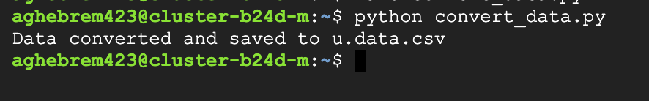
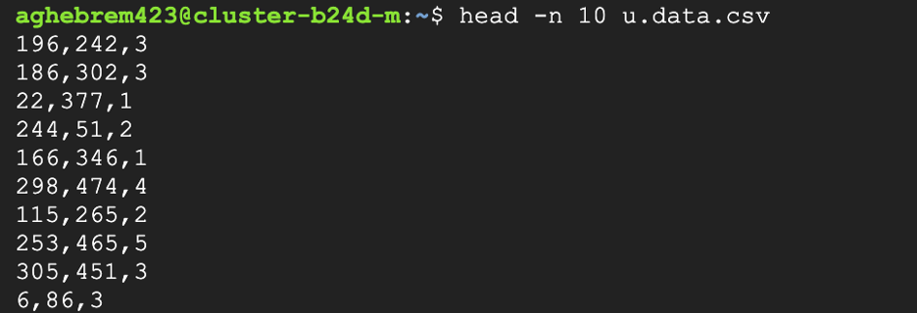
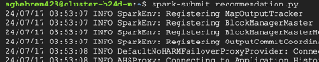
Cont.
Create and Run Data Conversion Script:
Collaborative Filtering Implementation:
Developed recommendation.py using Spark MLlib to build and evaluate the recommendation model.

Slide 9
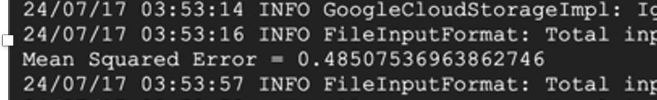
Testing
Objective: Validate the performance of the recommendation system.
Test Results:
Mean Squared Error (MSE).

Slide 10
Enhancement Ideas
Future Improvements:
Suggestions for optimizing the recommendation algorithm.
Scalability Considerations:
Approaches for handling larger datasets or more complex models.
Advanced Machine Learning Techniques:
Exploring deep learning or hybrid models for better recommendations.

Slide 11
Conclusion
Summary:
Successfully implemented a collaborative filtering recommendation system using Google Dataproc and Apache Spark.
Leveraged machine learning to provide personalized recommendations based on user data.
Key Outcomes:
Effective processing of large datasets with scalable cloud infrastructure.
Achieved meaningful results with a low Mean Squared Error (MSE), indicating accurate recommendations.
Next Steps:
Explore advanced techniques to further improve recommendation accuracy.
Consider scaling the system to handle even larger datasets and more complex models.

Slide 12
Reference
https://files.grouplens.org/datasets/movielens/ml-100k/u.data
https://hc.labnet.sfbu.edu/~henry/npu/classes/mllib/collaborative_filtering/slide/Examples.html

